Slide 1

MOVIE RECOMMENDATION SYSTEM
DSA0402-Fundamentals of Data Science and Data Management
SUPERVISED BY:
Dr. D. Manikavelan
Dr. M. Jayaprakash
SUBMITTED BY :
Nampalli Satish Kumar (192324128)
Lekkala Dattu Kumar (192324141)
D. V. Sai Kumar (192372321)

Slide 2
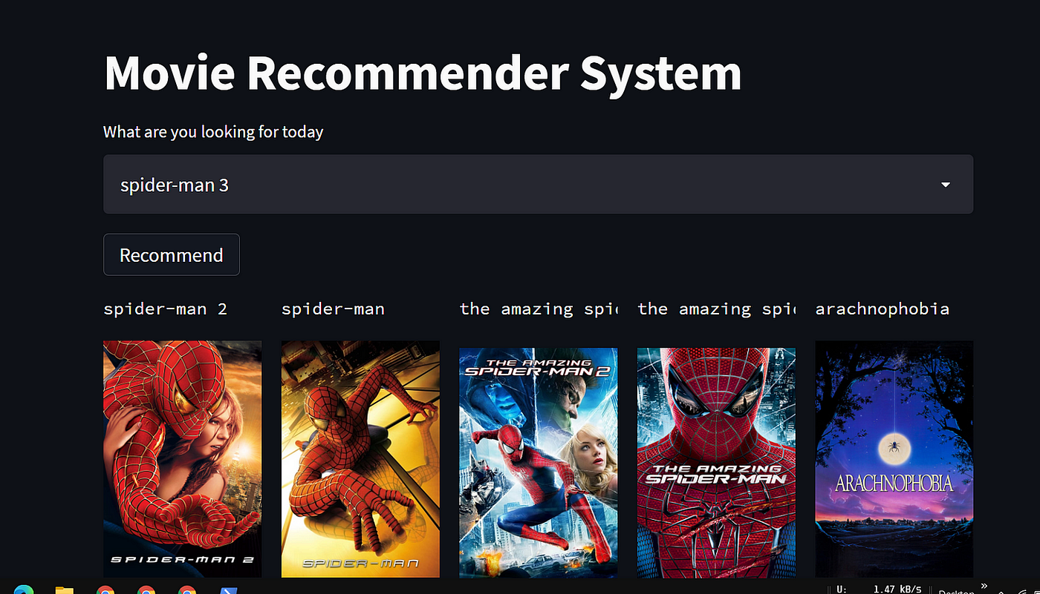
INTRODUCTION
A Movie Recommendation System analyzes large volumes of data such as user ratings, genres, reviews, and movie features. By applying techniques like collaborative filtering, content-based filtering, and hybrid recommendation methods, the system identifies patterns and predicts what a user is most likely to enjoy.
Such systems are widely used on popular platforms like Netflix, Amazon Prime Video, and Disney+, where personalized recommendations play a crucial role in user satisfaction. Implementing a Movie Recommendation System not only demonstrates the application of machine learning and data mining concepts but also highlights the importance of personalization in modern digital services.
.

Slide 3

ABSTRACT
The project focuses on building a Movie Recommendation System that provides personalized movie suggestions to users.
The system performs data preparation and feature extraction from movie datasets, including genres, descriptions, and user ratings.
Support Vector Machine (SVM) is used as the main model to classify and predict user preferences based on extracted features.
SVM helps in identifying patterns in high-dimensional movie data and improves the accuracy of recommendations.
Similarity analysis is applied to find relationships between movies and user viewing behavior.
The system combines content-based features and statistical modeling to generate reliable predictions.
The output provides a ranked list of recommended movies tailored to individual users.
The approach offers an efficient, intelligent, and accurate method for personalized movie discovery.

Slide 4
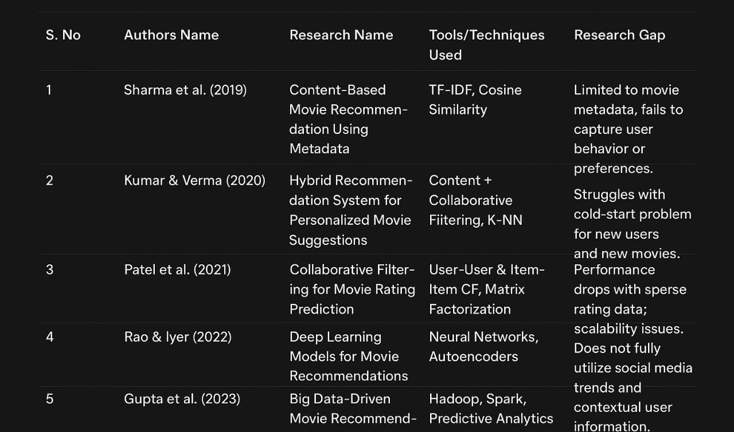
LITERATURE REVIEW

Slide 5
PROBLEM STATEMENT
The rapid growth of online movie platforms makes it difficult for users to manually select movies that match their interests.
Users often receive general or irrelevant movie suggestions, resulting in poor viewing experience.
Existing recommendation systems struggle to accurately predict user preferences due to large and complex movie datasets.
There is a need for a system that can automatically analyze user behavior, movie features, and rating patterns.
A robust machine learning model is required to classify and predict movies that a user is likely to enjoy.
Support Vector Machine (SVM) can effectively handle high-dimensional features and improve recommendation accuracy.
Therefore, the problem is to develop an SVM-based movie recommendation system that provides personalized, accurate, and meaningful movie suggestions to users.
.

Slide 6
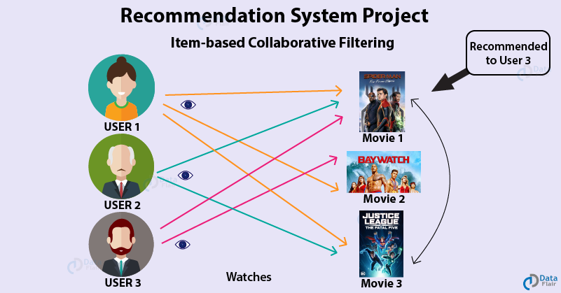
OBJECTIVES
To collect and prepare movie datasets containing genres, ratings, descriptions, and user information.
To extract meaningful features from movie data for effective recommendation.
To apply Support Vector Machine (SVM) for classifying user preferences and predicting suitable movies.
To compute similarity between movies and users based on extracted features.
To generate personalized movie recommendations with high accuracy.
To design a system that improves user experience by suggesting relevant movies.
To evaluate the performance of the recommendation system using appropriate metrics.
To create an efficient, scalable, and intelligent recommendation model.

Slide 7


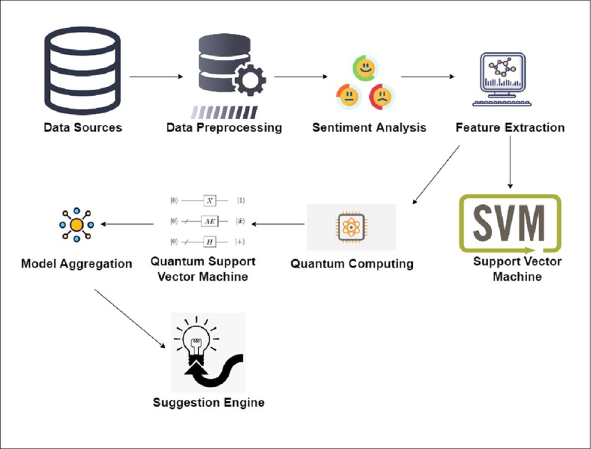
SYSTEM ARCHITECTURE DIAGRAM

Slide 8
1. Data Sources
You collect raw data (text, reviews, comments, feedback).
2. Data Preprocessing
remove noise, fix spelling, remove special characters, convert to lowercase
The aim is to make the text ready for analysis.
3. Sentiment Analysis
You check whether the text is:
Positive
Negative
Neutral
This helps understand the user’s emotion.
4. Feature Extraction
You convert text into numbers so that a machine can understand it. Example: TF-IDF, word embeddings, sentiment scores.
5. Support Vector Machine (SVM)
A normal (classical) SVM model learns from the features and predicts categories.

Slide 9
6. Quantum Computing
A quantum computer processes the data using quantum algorithms.
7. Quantum Support Vector Machine
A quantum version of SVM that may give faster or better results on certain problems.
8. Model Aggregation
You combine:
SVM results
Quantum SVM results
to get a better final decision.
9. Suggestion Engine
The final output is turned into useful recommendations or suggestions.
Example:
If sentiment is negative → suggest customer support
If sentiment is positive → suggest promotions
If user preferences detected → recommend products

Slide 10
MODULE 1 Data Preparation & Feature Extraction
Data Preparation
Collect movie datasets (MovieLens/TMDB/IMDb).
Load movie details (MovieID, Title, Genres).
Load user rating data (UserID, MovieID, Rating).
Clean the data:
Remove duplicates
Handle missing values
Standardize text fields
Convert genres into list format (e.g., "Action|Comedy").
Feature Extraction
Genre Features: Convert genres into numerical vectors using one-hot/multi-label encoding.
Text Features (optional): Extract features from movie descriptions or tags using TF-IDF or count vectorizer.
User–Movie Rating Matrix: Create a matrix with.
Columns = Movies
Values = Ratings
Similarity Features: Prepare cosine similarity inputs:
Content-based similarity (genres/tags vectors)
Collaborative filtering similarity (ratings matrix)

Slide 11
MODULE 2 Similarity Calculation & Statistical Modeling
Similarity Calculation
Cosine Similarity (Content-Based): Calculate similarity between movies using:
Genre vectors
tag vectors
User–User Similarity (Collaborative Filtering): Measure similarity between users based on their rating patterns.
Item–Item Similarity (Collaborative Filtering): Calculate similarity between movies based on how users rated them.
Statistical Modeling
Correlation Analysis: Identify movies that have high rating correlation.
Matrix Factorization (optional): Use SVD to reduce dimensionality and capture hidden features.
Predicting Ratings: Estimate a user’s rating for an unseen movie using:
Weighted average of similar users

Slide 12
MODULE 3 Recommendation Algorithm Implementation
1. Content-Based Recommendation
Extract movie feature vectors (genres, tags, descriptions).
Calculate cosine similarity between movies.
Identify movies most similar to the user’s liked movie(s).
2. User–User Collaborative Filtering
Build user–movie rating matrix.
Calculate similarity between users using cosine similarity.
Identify users with similar rating patterns.
3. Item–Item Collaborative Filtering
Compare movies based on user rating patterns.
Calculate similarity between movie rating vectors.
4. Hybrid Recommendation (Optional)
Combine content-based and collaborative filtering results.
Weight both models to generate final recommendations.
Provide more accurate and diverse movie suggestions.

Slide 13
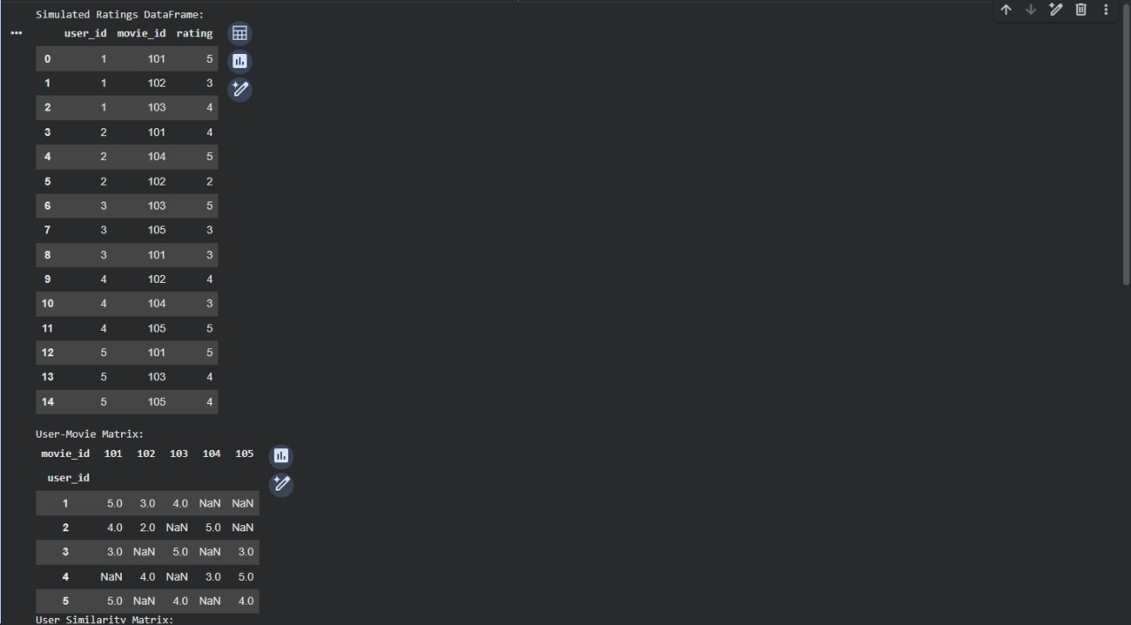
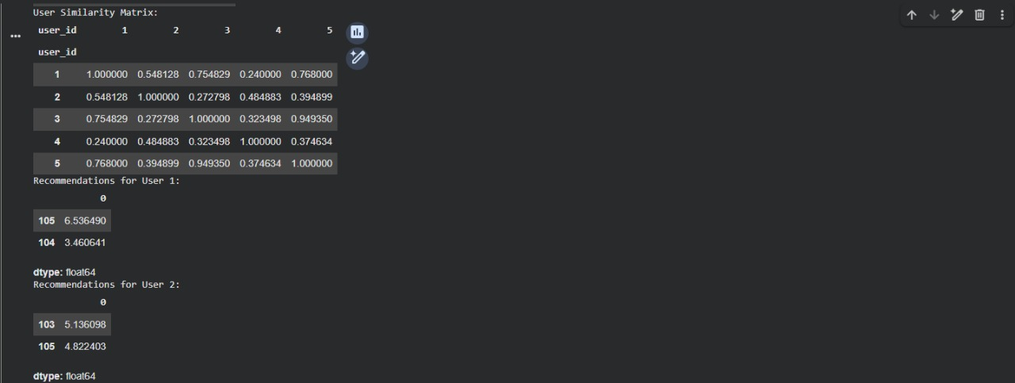
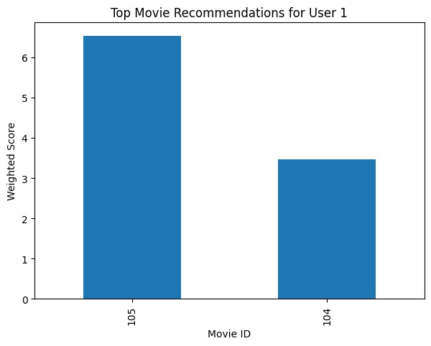
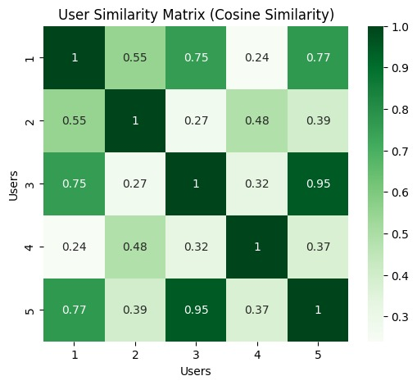
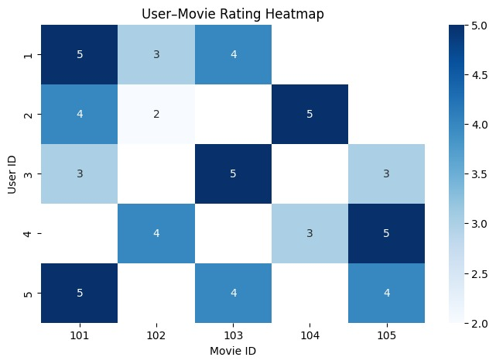
RESULTS/OUTPUT

Slide 14
CONCLUSION
The SVM-based Movie Recommendation System successfully provides personalized movie suggestions to users.
By using proper data preparation and feature extraction, the system effectively captures meaningful patterns from movie datasets.
Support Vector Machine (SVM) improves prediction accuracy by handling complex and high-dimensional features.
Similarity analysis further enhances the quality of recommendations by identifying relationships between movies and user preferences.
The system delivers relevant and ranked movie recommendations that help users make better choices.
Overall, the proposed model demonstrates an intelligent and efficient approach to movie recommendation, improving user satisfaction and decision-making.
The project also provides a foundation for future enhancements like hybrid models and deep learning-based recommendations.

Slide 15
REFERENCES
Liu, Q., Zeng, Y., & Tao, C. (2019). “Collaborative Filtering Recommendation Algorithm Based on Support Vector Machine.” Journal of Intelligent & Fuzzy Systems, 36(1), 337–346.
Gunawan, D., & Suharjito. (2020). “Movie Recommendation System Using Support Vector Machine and KNN.” International Journal of Advanced Computer Science and Applications, 11(5), 234–240.
Al-Shamri, M. Y. H. (2020). “User Profiling Approaches for Personalized Recommender Systems Using SVM.” IEEE Access, 8, 10200–10212.
Sahoo, A. K., & Kumar, R. (2021). “An Enhanced Recommendation Model Using SVM-Based Feature Classification.” Procedia Computer Science, 192, 4270–4279.
Reddy, P. S., & Kumar, M. S. (2022). “SVM-Based Hybrid Recommender System for Improving Prediction Accuracy.” International Journal of Intelligent Engineering and Systems, 15(3), 260–270.
Khan, M. A., & Ahmad, F. (2021). “SVM-Based Classification Approach for Building Efficient Recommendation Models.” Applied Computing and Informatics, 17(2), 186–195.
Li, X., Wang, H., & Chen, Y. (2022). “Improving Movie Recommendations Using SVM-Driven Feature Analysis.” Expert Systems with Applications, 187, 115892.

Slide 16

THANK YOU

